Slide 1










EU GREEN ACADEMIC RETREAT
Joint Futures: Innovating International Programs through Virtualization, AI and Languages
15–16 October 2026
Badajoz, Spain
UNIVERSITY OF EXTREMADURA
Practical Information for Participants

Slide 2
Recommended Hotels and Aparthotel
AC Hotel Badajoz
• Avenida de Elvas
• UEx: 2.5 km (6 min by car / 25 min walking)
• City centre: 2.5 km (30 min walking)
• €88
Hotel TURIA
• Avenida Augusto Vázquez, 2
• UEx: 3 km
• City centre: 1.2 km (15 min walking)
• €90
Hotel Río Badajoz
• Near historic centre
• UEx: 3 km
• City centre: 15 min walking
• €64

Slide 3
More Accommodation
Sercotel Gran Hotel Zurbarán
• Historic centre
• UEx: 5 km
• €70–110
Hotel Las Tres Campanas
• Plaza Soledad (city center)
• UEx: 5 km
• €70–100
Hotel Las Bóvedas
• Near motorway
• UEx: 3 km
• €60–90
Aparthotel MM
• Apartments with kitchenette
• UEx: 1.6 km (4 min / 22 min walking)
• City centre: 2 km
• €70–110

Slide 4
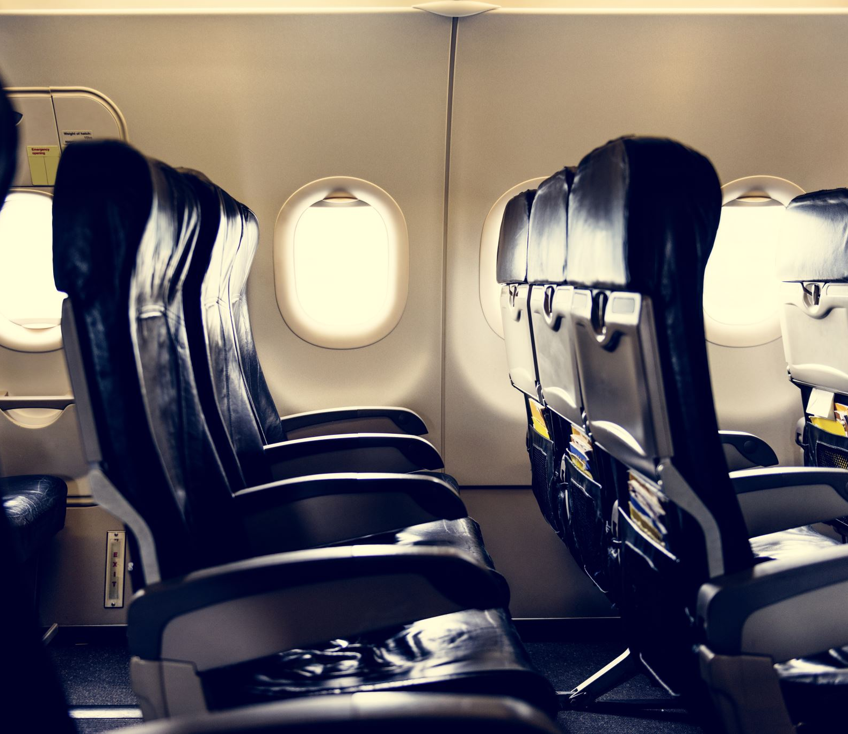
Travel from Madrid
By Plane
• Direct flights Madrid–Badajoz
• Flight time: approx. 1 h 20 min
• Afternoon arrival on 14 October
• Return: Saturday 17 October
By Train
• Madrid Atocha – Badajoz
• 4–6 hours depending on service

Slide 5
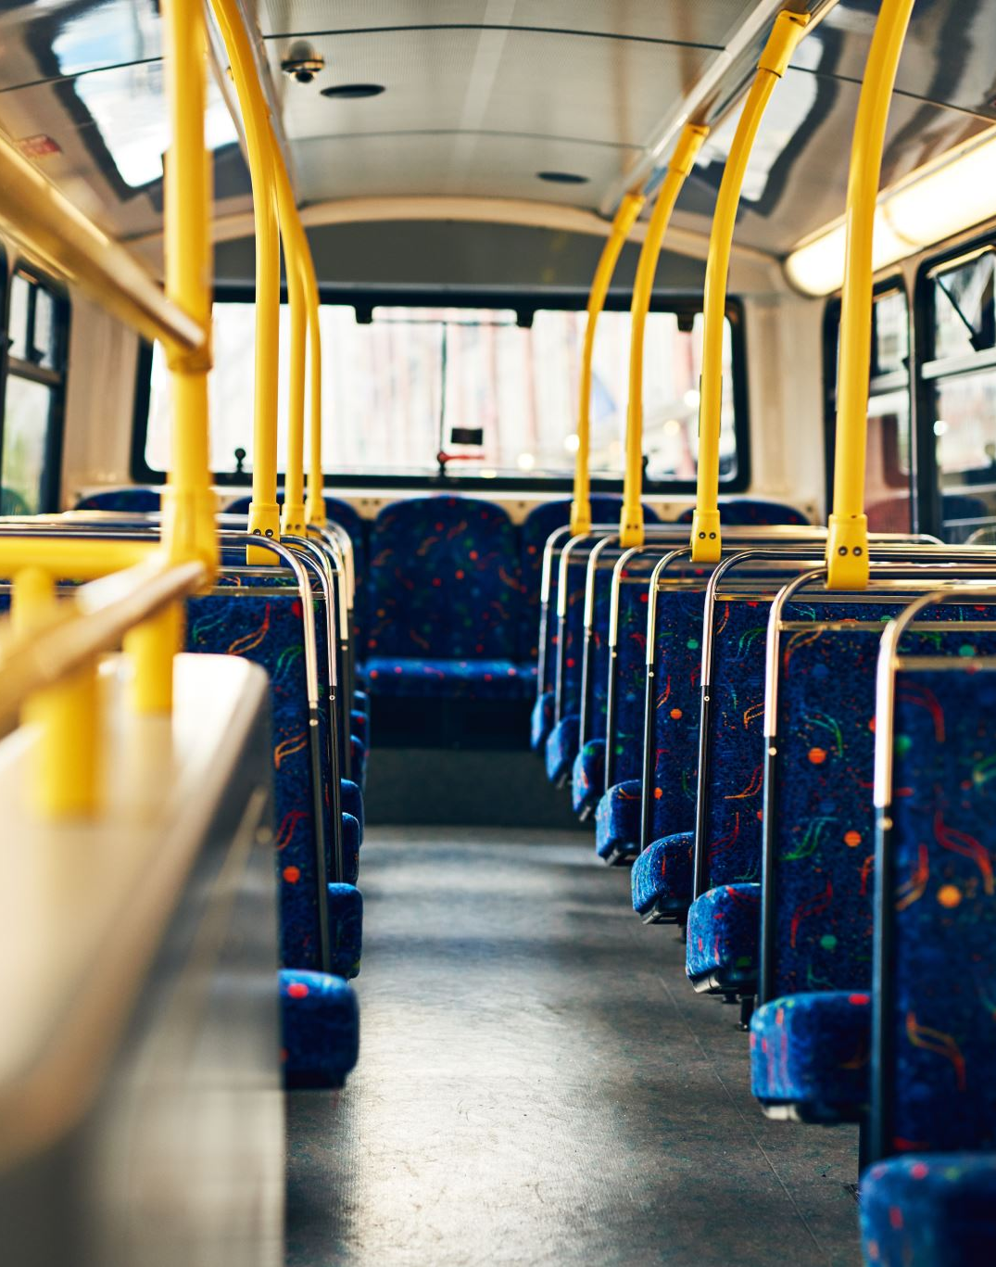
Travel from Lisbon
By Car
• 225 km
Aprox 2 h 15
By Bus
Operators:
• FlixBus
• Rede Expressos
• BlaBlaCar Bus
Journey:
Aprox 3 h

Slide 6
Travel from Seville
By Car
• 190 km
• 2 h 15
By Bus
Operators:
• BaseBus
• ALSA
• Regional operators
Journey:
Aprox 3 h 15
Around five daily connections.

Slide 7

Additional Notes
Participants are advised to arrive on the afternoon of 14 October.
Taxis and local buses are available from both the airport and train station.
Hotel prices may vary depending on availability and booking dates.
We wish you a pleasant stay in Badajoz and look forward to welcoming you to the University of Extremadura.

